Slide 1
Modena Borough and PECO Project update
Tuesday September 2, 2025

Slide 2
PECO Project Overview
PECO will be completing a gas expansion project impacting East Fallowfield township and Modena Borough
The purpose of this project is to provide more gas capacity on our system to both residential and commercial customers
The borough will see a closure of Hephzibah Hill Rd for several weeks due to the scope of work needed
All work in East Fallowfield has been completed
Danella is our qualified contractor who will be performing the work with oversight from PECO

Slide 3
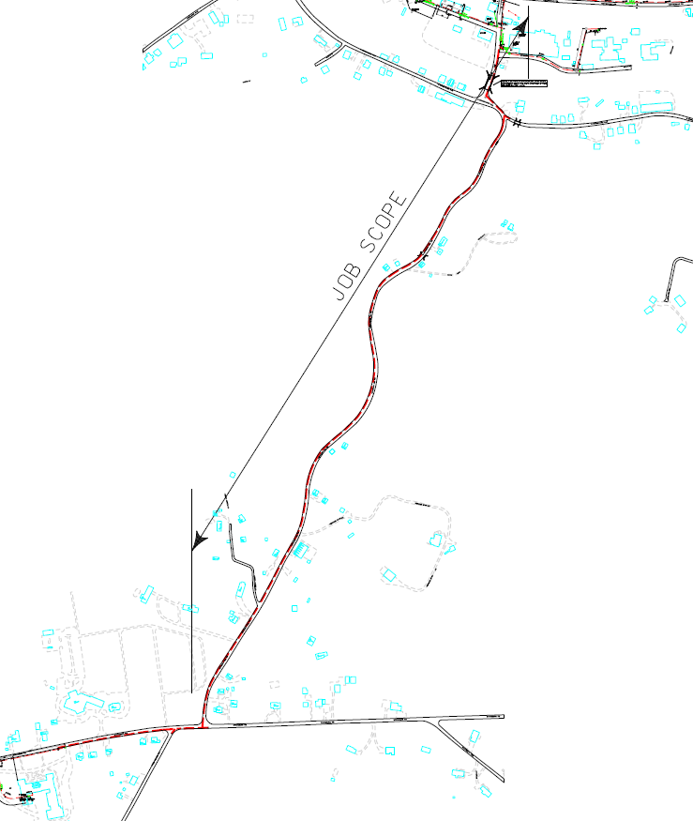
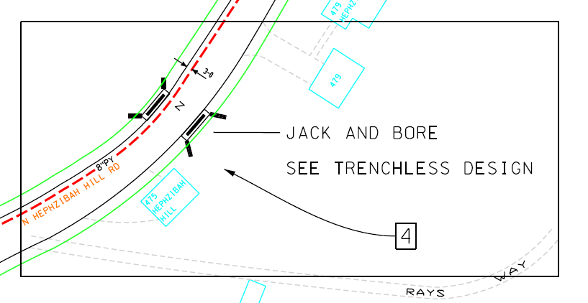
Project Map
Work remaining from Phoenix Court and Union Street to Township border on Hephzibah Hill Road (SR 3047)

Slide 4
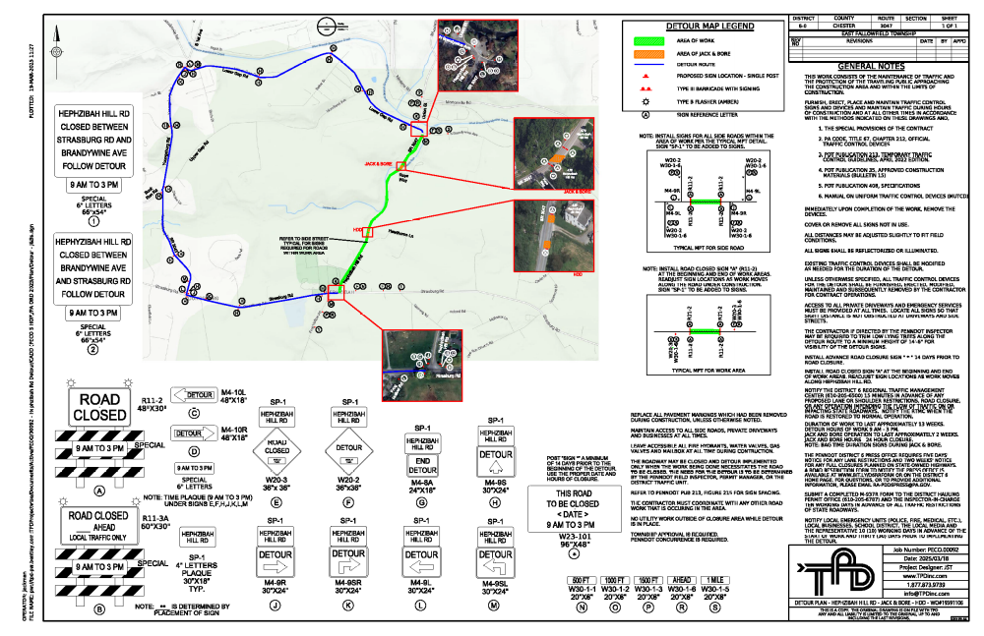
Detour Plans

Slide 5
Communication plan/Schedule
PECO and Danella will be providing weekly updates to the borough
The Borough will have a direct contact at Danella incase residents have questions/comments
We have been in contact with PennDot, local police/fire/EMS and school district
We anticipate work to begin around 9/15/25
Residents directly along Hephzibah Hill Road will have an opportunity to hook up to PECO Natural gas at a discounted rate

Slide 6
Resources
Natural Gas for Your Neighborhood | PECO - An Exelon Company
Gas Efficiency Upgrade for Your Home | PECO - An Exelon Company

